Slide 1
Northern Hammer*
Hardware Retailers
Sales analysis
Making the future more profitable again
Johan Pelssers
Codecademy
September 29th, 2025
Data Analyst
Data Analysis Bootcamp Project Assignment 1 - Sales Dashboard
*Fictional Company & Data Any resemblance to actual persons, places, or events is purely coincidental.

Slide 2
NORTHERN HAMMER | SALES ANALYSIS - MAKING THE FUTURE MORE PROFITABLE AGAIN
01
Project
Overview
Approach
Data Exploration
Data Preparation
Exploratory Data Analysis
Key Insights

Slide 3
NORTHERN HAMMER | SALES ANALYSIS - MAKING THE FUTURE MORE PROFITABLE AGAIN
02
Project
Problem
Lack of clear, data-driven understanding of regional performance
Aim
Uncover trends and evaluate profitability
Purpose
Support strategic decision-making
Questions
Are there seasonal effects?
What are the top 10 selling products?
What are the most common sales channels?
Is there inconsistent revenue and profit performance across regions?
Approach
Leverage 4 years of sales data (2014-2017) to pinpoint growth levers and optimise strategy

Slide 4
NORTHERN HAMMER | SALES ANALYSIS - MAKING THE FUTURE MORE PROFITABLE AGAIN
03
Approach
Data Exploration
Data Preparation
Exploratory Data Analysis
Key Insights
Gather data files
Explore data files to gain understanding of data content and structure
Identify key variables for business questions
Integrate data files
Handle missing data
Feature scaling*
Identify outliers*
Transform data
Describe data
Univariate Analysis
Multivariate Analysis*
Identify key contributors with regard to research questions
*not included yet, added step by step when project enters multivariate analysis stage

Slide 5
NORTHERN HAMMER | SALES ANALYSIS - MAKING THE FUTURE MORE PROFITABLE AGAIN
04
Data Exploration
Sales Data
Sales Records
Product Line
The data includes the sales data of Northern Hammer over a 4 year time period, from January 2014 until February 2018
The data includes a total of 64,104 Sales Records. Each record has a sales date which can be used for seasonal analysis.
The sales are marked for the entire Northern Hammer product line, a total of 30 DIY and Home improvement products
MONTHS
ORDERS
PRODUCTS
50
64K+
30

Slide 6
NORTHERN HAMMER | SALES ANALYSIS - MAKING THE FUTURE MORE PROFITABLE AGAIN
05
Data Exploration
Customers
Country-wide
Region
There have been 175 U.S. organisations as our customers
Customers located in 412 counties with 220 unique region codes over the 4 regions: NorthEast, MidWest, South, West
There are 10 metrics for each region of the customer: type, latitude and longitude, area code, population, households, median income, land and water area, and time zone.
COMPANIES
STATES
AREA DEMOGRAPHICS
175
48
10

Slide 7
NORTHERN HAMMER | SALES ANALYSIS - MAKING THE FUTURE MORE PROFITABLE AGAIN
06
Data Exploration
Distribution
Delivery
Sales Metrics
The Northern Hammer products are distributed through three channels: Wholesale, Distributor, Export.
The Northern Hammer products are distributed from our 4 NH warehouses.
Each order lists order quantity, order unit price, total order price, and unit cost price. These are key outcome metrics for our analysis.
CHANNELS
WAREHOUSES
KEY METRICS
3
4
4

Slide 8
NORTHERN HAMMER | SALES ANALYSIS - MAKING THE FUTURE MORE PROFITABLE AGAIN
07
Data Preparation
Handling Missing Data
Feature Scaling
Outliers
Transform Data
The data is complete. No missing values are reported for the key variables.
For specific variables, some of the values may be considering to be missing based on impossible entries (e.g., 0 median income or population in specific regions).
When these variable would be used as predictors in multivariate analysis, this needs to be investigated based on domain knowledge. Missing data can be imputed*
There is significant skewness in specific region predictor variables. Before conducting a predictive analysis, feature scaling needs to be applied*
There are outliers among specific predictor variables. Before conducting a predictive analysis, outlier correction needs to occur*
Cost is calculated based on unit cost * amount of units in the order
Profit is calculated by subtracting cost from total order price
Profit Margin by dividing total order price by cost * 100
Profit & Profit Margin quartile groups are calculated
Year, Quarter and Month, and their dummy variables were derived from date
*not included yet, added step by step when project enters multivariate analysis stage

Slide 9
NORTHERN HAMMER | SALES ANALYSIS - MAKING THE FUTURE MORE PROFITABLE AGAIN
08
Exploratory
Data
Analysis
Seasonal Sales, Revenue & Profit Analysis
Top Selling Products
Distribution Channels
Regional Sale Differences

Slide 10
The Seasonal in
Orders, Revenue, Profit

Slide 11
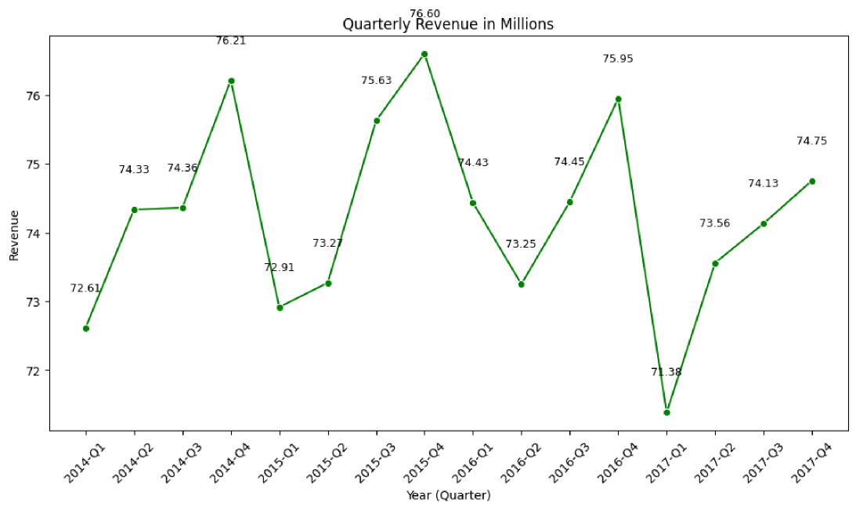
NORTHERN HAMMER | SALES ANALYSIS - MAKING THE FUTURE MORE PROFITABLE AGAIN
10
Revenue Per Quarter 2014-17
298M
REVENUE PER YEAR IN 2014-2016
293M
LOWER YEAR REVENUE IN 2017
Q3 & Q4
YEARLY HIGH REVENUE QUARTERS
Q1 & Q4
LOWER REVENUES IN 2017

Slide 12
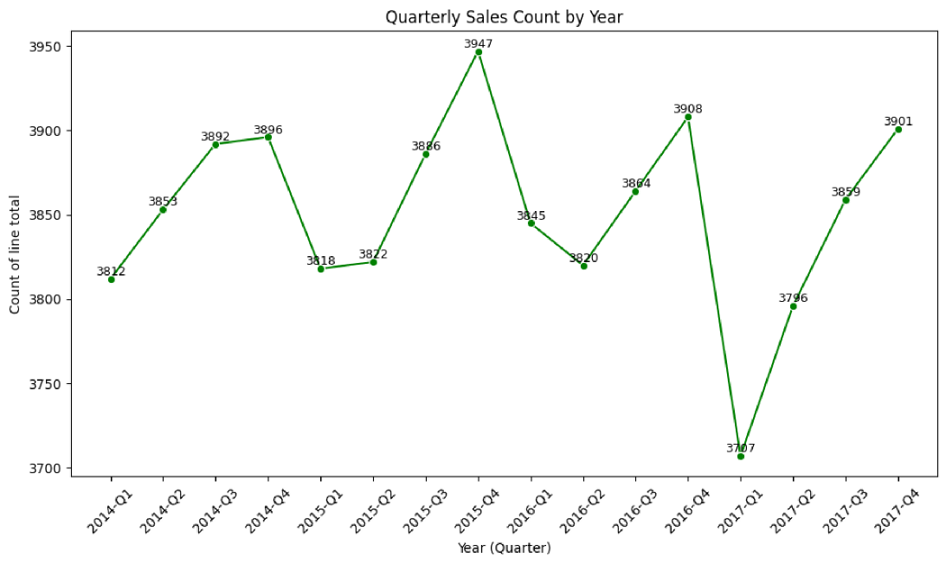
NORTHERN HAMMER | SALES ANALYSIS - MAKING THE FUTURE MORE PROFITABLE AGAIN
11
#Orders Per Quarter for 2014-17
15,5K
NUMBER OF ORDERS PER YEAR
3,85K
NUMBER OF ORDERS PER QUARTER
Q1 vs Q4
LOWER NUMBER OF ORDERS IN Q1&Q2
DROP IN NUMBER OF ORDERS IN 17-Q1
Q4 STRONGEST NUMBER OF ORDERS

Slide 13
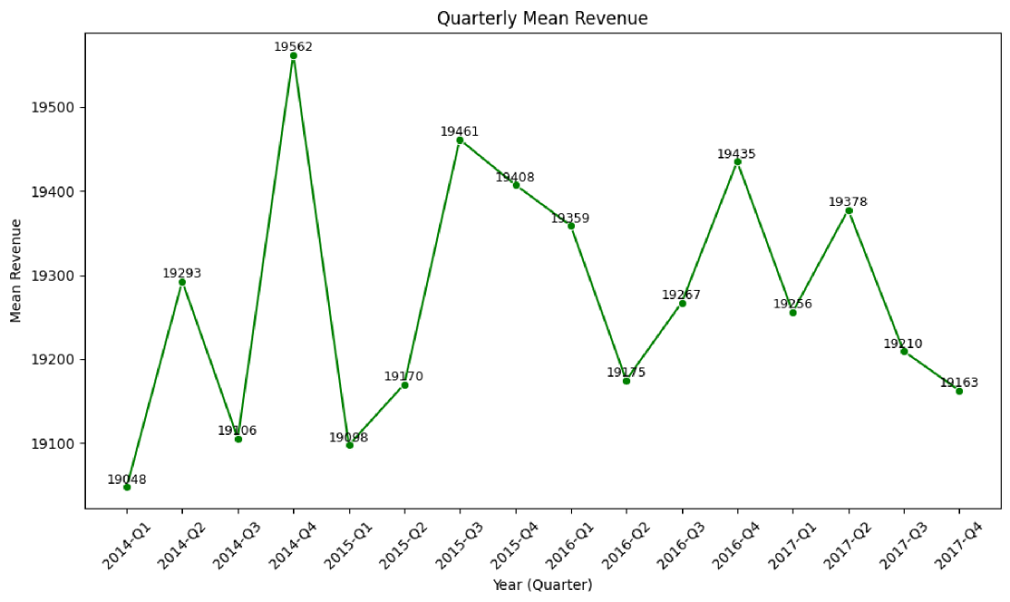
NORTHERN HAMMER | SALES ANALYSIS - MAKING THE FUTURE MORE PROFITABLE AGAIN
12
Mean Revenue/Order Per Quarter for 2014-17
19,3K
MEAN REVENUE PER ORDER PER YEAR
Q3-4 2017
17 DROP IN AVERAGE REVENUE/ORDER
Q1 2017
HIGHER REVENUE/ORDER VS. 14-15
LOWER REVENUE/ORDER VS. 16

Slide 14
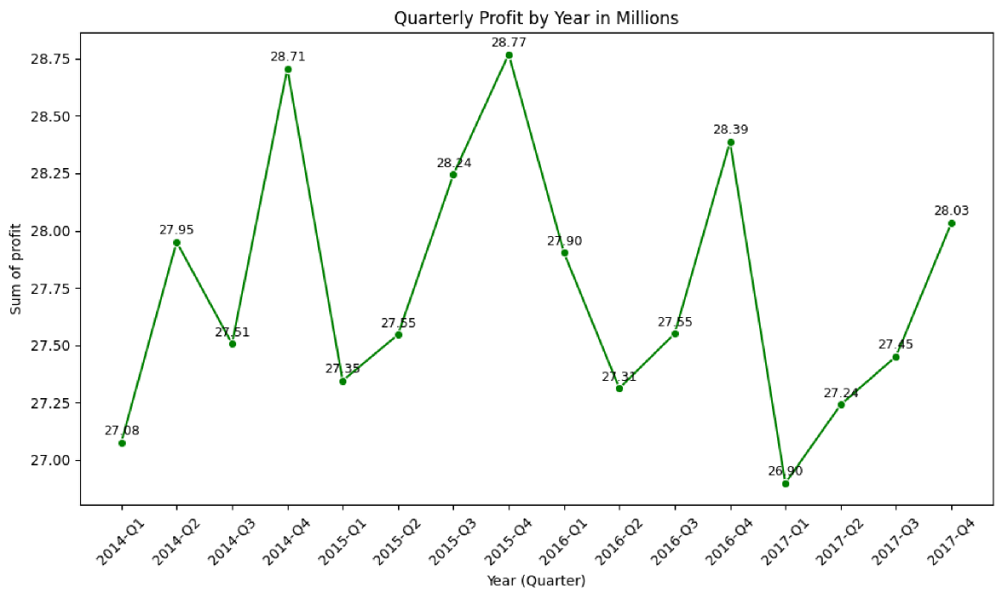
NORTHERN HAMMER | SALES ANALYSIS - MAKING THE FUTURE MORE PROFITABLE AGAIN
13
Profit Per Quarter for 2014-17
1.6M
LESS PROFIT THAN AVERAGE YEAR

Slide 15
NORTHERN HAMMER | SALES ANALYSIS - MAKING THE FUTURE MORE PROFITABLE AGAIN
14
Key Insights
Yearly less revenue in Q1&2
Stronger Q3-4 Seasons
Revenue suffered in 2017
Realised $5M less revenue
Lower Sales (Orders) in Q1 of 2017
Lowest in #orders in 4 years
Lower Revenue per Order in Q4 of 2017
Lower revenue realised per order in Q4 than other years

Slide 16
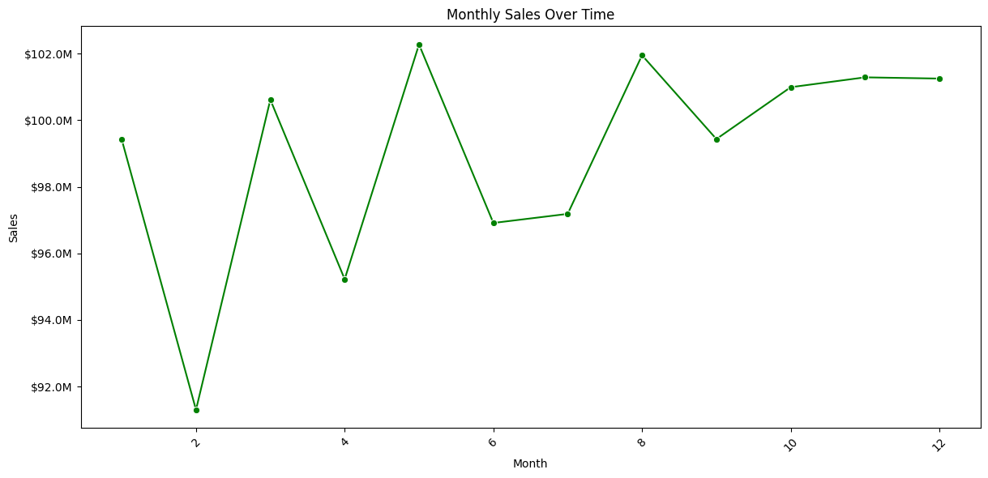
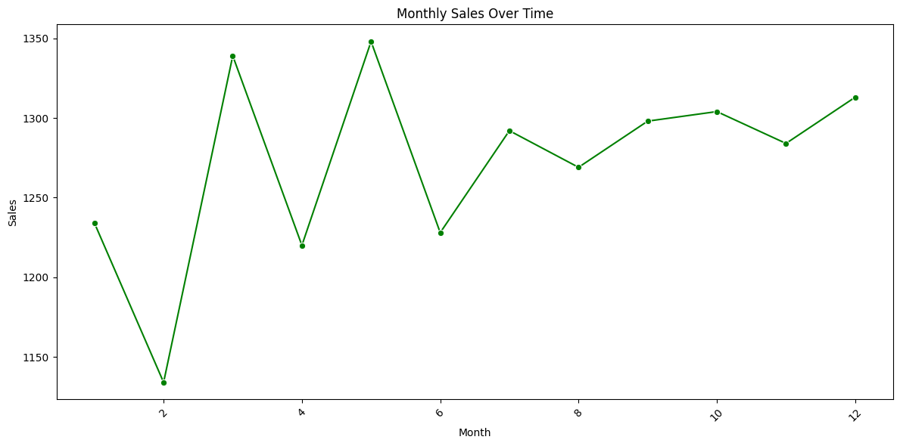
NORTHERN HAMMER | SALES ANALYSIS - MAKING THE FUTURE MORE PROFITABLE AGAIN
15
Total Orders per Month for 2014-17
February
YEARLY LOWER ORDERS
Y1st half
TOP 4 LOWEST ORDERS MONTHS ARE IN THE FIRST SEMESTER OF YEAR

Slide 17
NORTHERN HAMMER | SALES ANALYSIS - MAKING THE FUTURE MORE PROFITABLE AGAIN
16
Total Revenue per Month for 2014-17
Orders
ORDER NUMBERS DRIVE REVENUE
Q4
STRONGEST QUARTER OF YEAR
RANK 3, 4 AND 5 IN #ORDERS

Slide 18
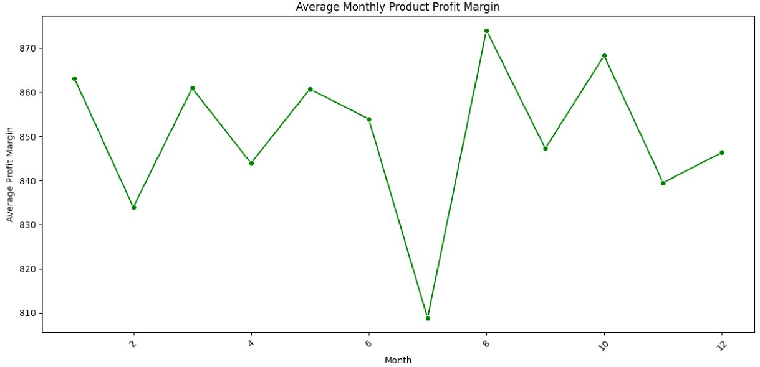
NORTHERN HAMMER | SALES ANALYSIS - MAKING THE FUTURE MORE PROFITABLE AGAIN
17
Average Monthly Profit Margin per Sold Unit for 2014-2017
July
SIGNIFICANT LOWER
PROFIT MARGINS PER SOLD UNIT
DESPITE HIGHER NUMBER OF ORDERS
LOWER REVENUE AND PROFIT IN JULY

Slide 19
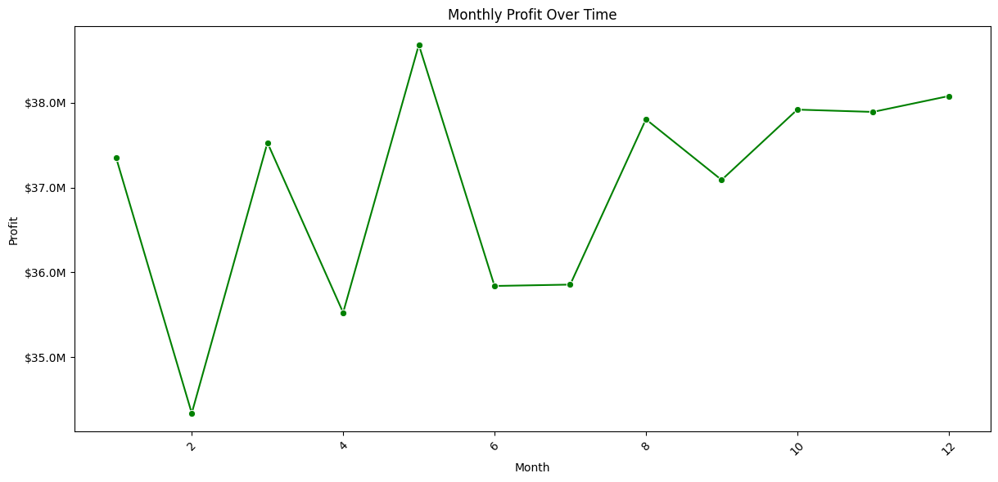

NORTHERN HAMMER | SALES ANALYSIS - MAKING THE FUTURE MORE PROFITABLE AGAIN
18
Total Profit per Month for 2014-17
Profit
STRONGLY FOLLOWS REVENUE
July
PROFIT AFFECTED BY SIGNIFICANT LOWER
PROFIT MARGINS PER SOLD UNIT

Slide 20
NORTHERN HAMMER | SALES ANALYSIS - MAKING THE FUTURE MORE PROFITABLE AGAIN
19
Key Insights
Revenue highest in 2nd half of year
Strong Q4
Low Revenue in February
Also April is a lower revenue month
Profit follows revenue (sales)
#Orders is driver of revenue and profit
Profit Margin per Sold Unit is Low in July
Lower revenue and profit in July

Slide 21
Top 10 Sold & Grossing Products

Slide 22
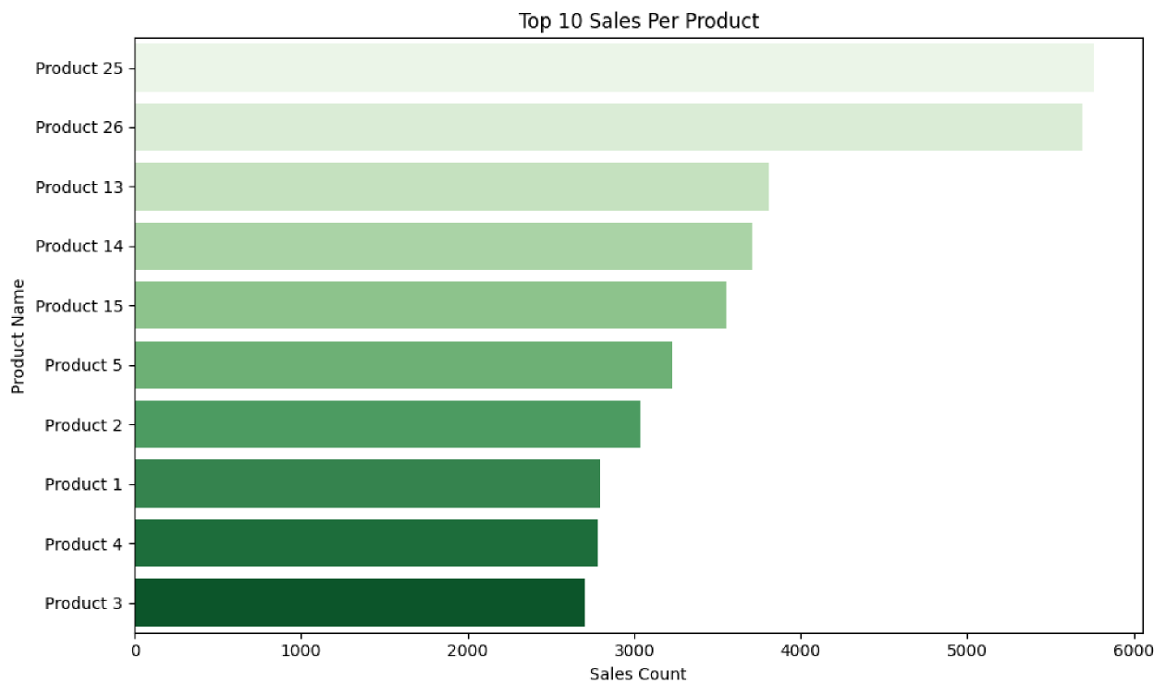
NORTHERN HAMMER | SALES ANALYSIS - MAKING THE FUTURE MORE PROFITABLE AGAIN
21
Total Orders per Product for 2014-17
18.5%
PRODUCTS 25 AND 26 ARE
THE MOST ORDERED PRODUCTS.
THEY ACCOUNT FOR 18.5% OF ORDERS.
60%
TOP 10 ORDERED PRODUCTS
GENERATE 60% OF THE REVENUE

Slide 23
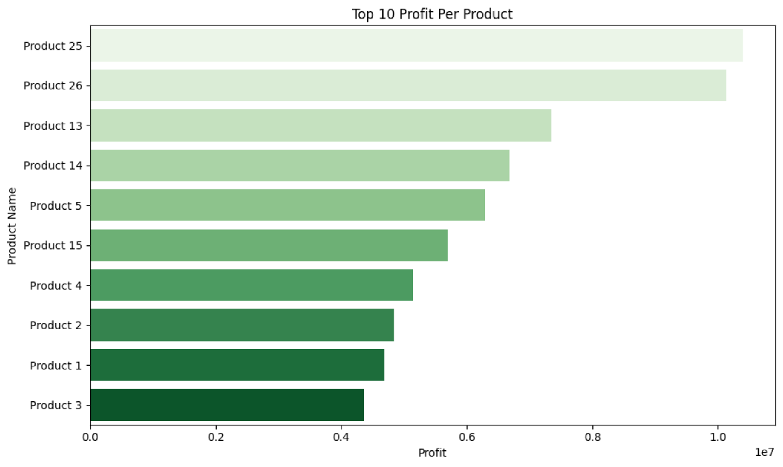
NORTHERN HAMMER | SALES ANALYSIS - MAKING THE FUTURE MORE PROFITABLE AGAIN
22
Total Profit per Product for 2014-17
18.5%
PRODUCTS 25 AND 26 ARE THE MOST PROFIT GENERATING PRODUCTS.
THEY ACCOUNT FOR 18.6% OF PROFIT
60%
TOP 10 ORDERED PRODUCTS
GENERATE 60% OF THE PROFIT

Slide 24
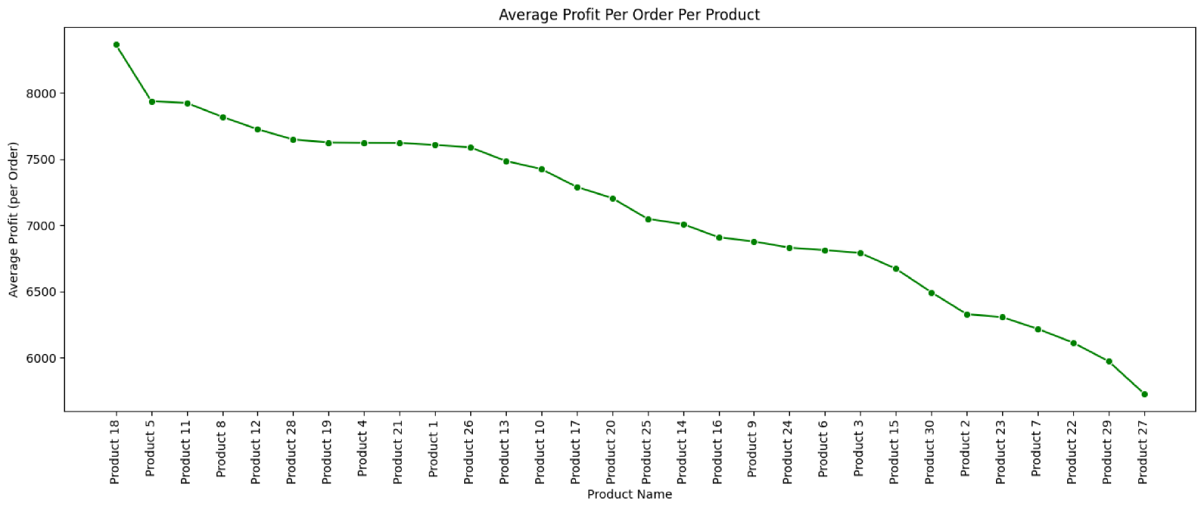

NORTHERN HAMMER | SALES ANALYSIS - MAKING THE FUTURE MORE PROFITABLE AGAIN
23
Average Profit per Product for 2014-17
Medium
MARGINS FOR THE MOST SELLING PRODUCTS

Slide 25
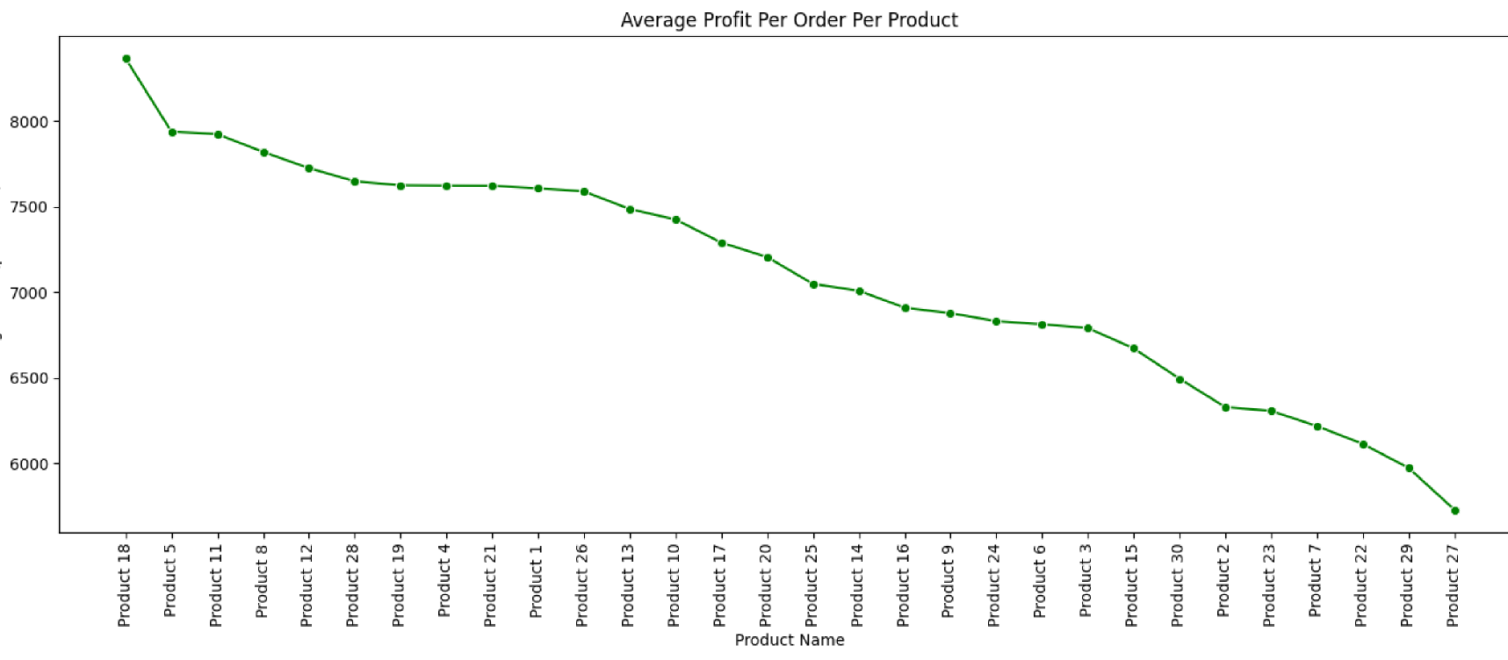
NORTHERN HAMMER | SALES ANALYSIS - MAKING THE FUTURE MORE PROFITABLE AGAIN
24
Average Profit per Product for 2014-17
3 of top 10 product orders
ARE IN TOP 10 OF PROFIT PER SALE

Slide 26
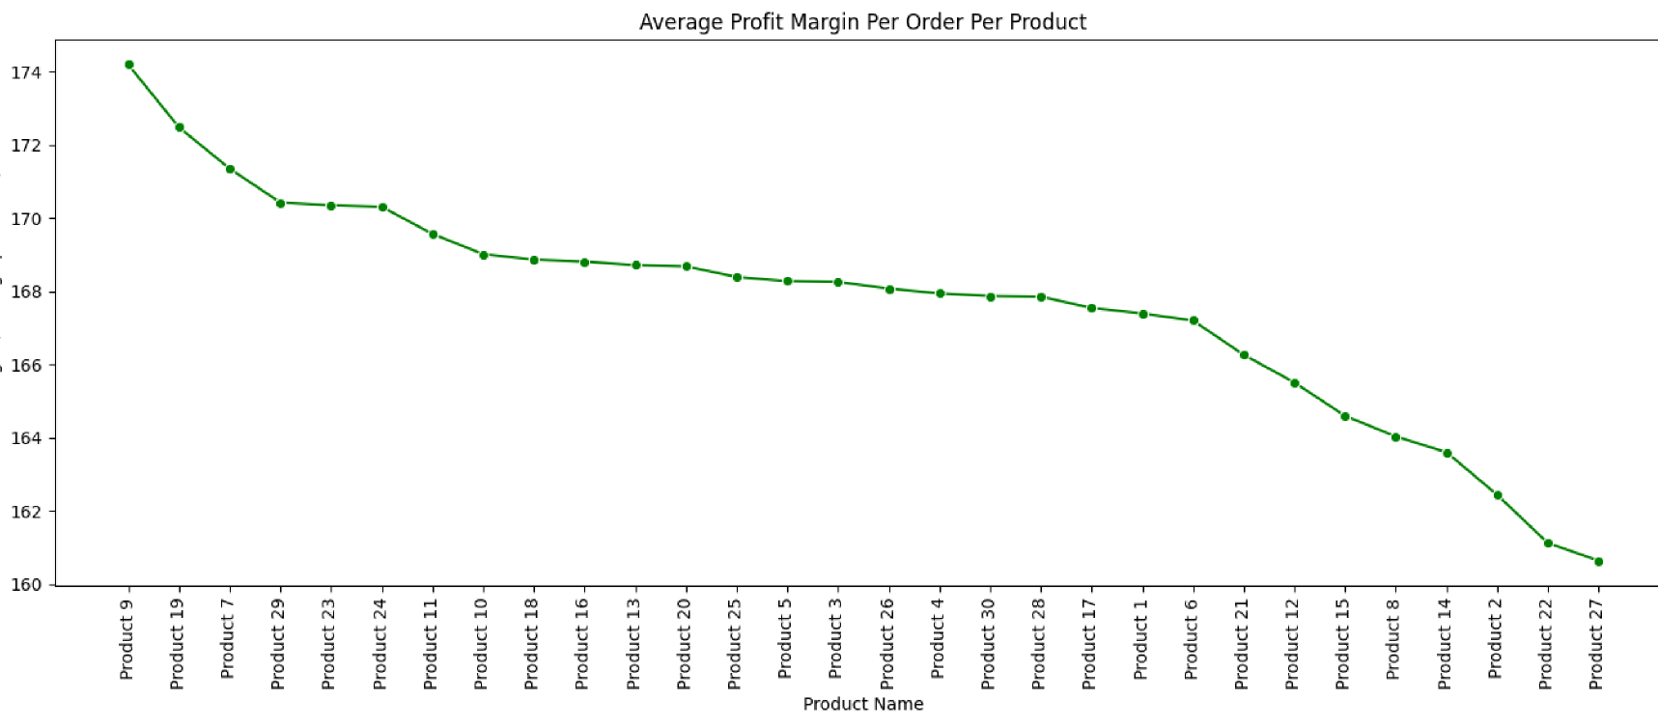
NORTHERN HAMMER | SALES ANALYSIS - MAKING THE FUTURE MORE PROFITABLE AGAIN
25
Average Profit Margin per Product for 2014-17
None
of the products in top 10 of orders
ORDERS ARE IN THE TOP 10 PRODUCTS WITH THE HIGHEST PROFIT MARGIN PER PRODUCT

Slide 27
NORTHERN HAMMER | SALES ANALYSIS - MAKING THE FUTURE MORE PROFITABLE AGAIN
26
Key Insights
Quantity of Orders drives Revenue and Profit
Revenue and Profit driving products
Top 2 → Products 25-26 → is responsible for 18% Top 10 → is responsible for 60%
Most ordered product → not highest profit
The majority of products that are ordered most often (top 10) are not in the top 10 of average profit per sale.
Most ordered product → not highest margin
All products that are ordered most often (top 10) are not in the top 10 of profit margin per sold unit.

Slide 28
Distribution
Channels

Slide 29
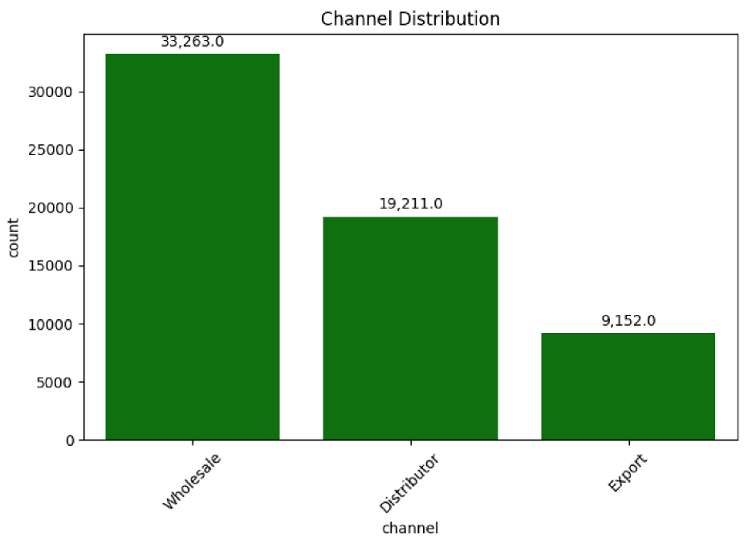
NORTHERN HAMMER | SALES ANALYSIS - MAKING THE FUTURE MORE PROFITABLE AGAIN
28
Distribution Channels 2014-2017
54%
WHOLESALE
31%
DISTRIBUTOR
15%
EXPORT

Slide 30
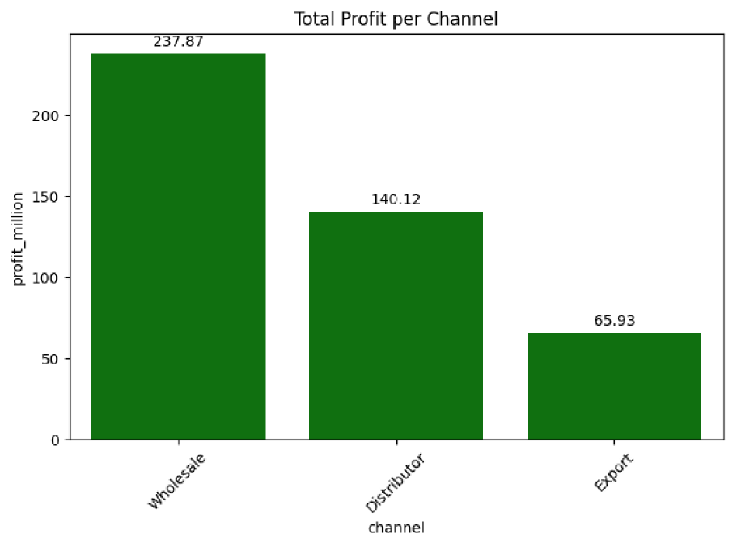
NORTHERN HAMMER | SALES ANALYSIS - MAKING THE FUTURE MORE PROFITABLE AGAIN
29
Profit per Channel 2014-2017
54%
WHOLESALE
31%
DISTRIBUTOR
15%
EXPORT

Slide 31
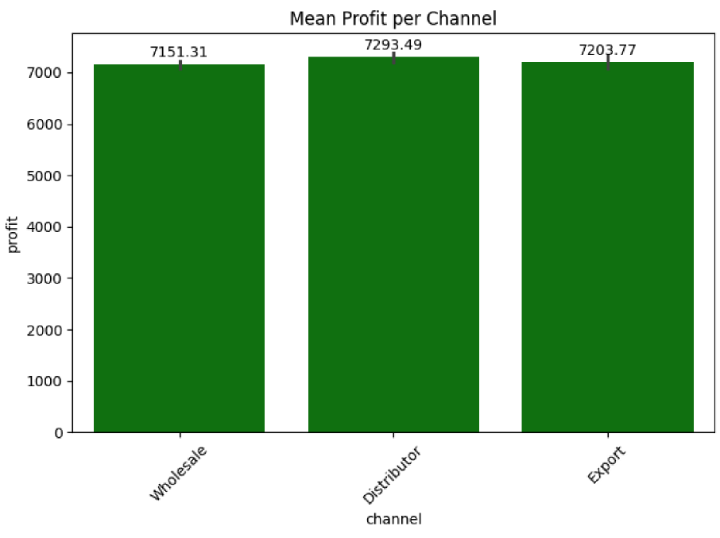
NORTHERN HAMMER | SALES ANALYSIS - MAKING THE FUTURE MORE PROFITABLE AGAIN
30
Mean Order Profit per Channel 2014-2017
7,2K
MEAN PROFIT PER CHANNEL
Equal
MEAN PROFIT PER ORDER

Slide 32
NORTHERN HAMMER | SALES ANALYSIS - MAKING THE FUTURE MORE PROFITABLE AGAIN
31
Key Insights
Wholesale → 50%+ of all orders and profit
Outperforms other channels
~ Double as much as Distributors ~ Triple as much as Export
Equal average profit per order
The average profit per order is equal for all channels

Slide 33
Regional
Orders & Profits

Slide 34
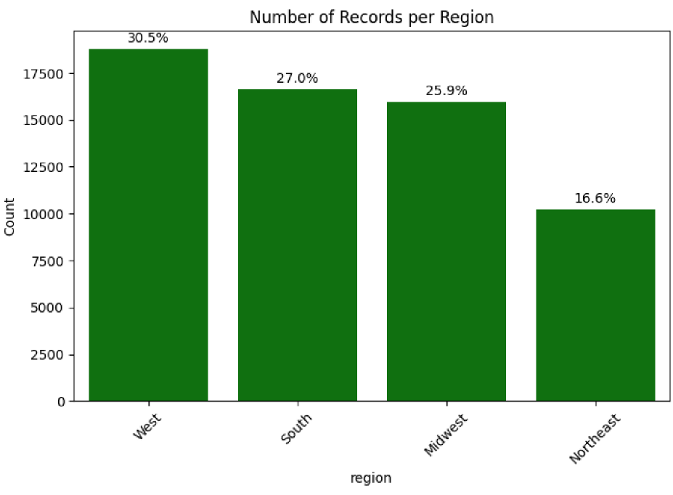
NORTHERN HAMMER | SALES ANALYSIS - MAKING THE FUTURE MORE PROFITABLE AGAIN
33
Orders per Region 2014-2017
18,8K
MOST ORDERS IN THE WEST
10,2K
LOWEST ORDERS IN THE NORTH EAST
~16,2K
SOUTH AND MIDWEST

Slide 35
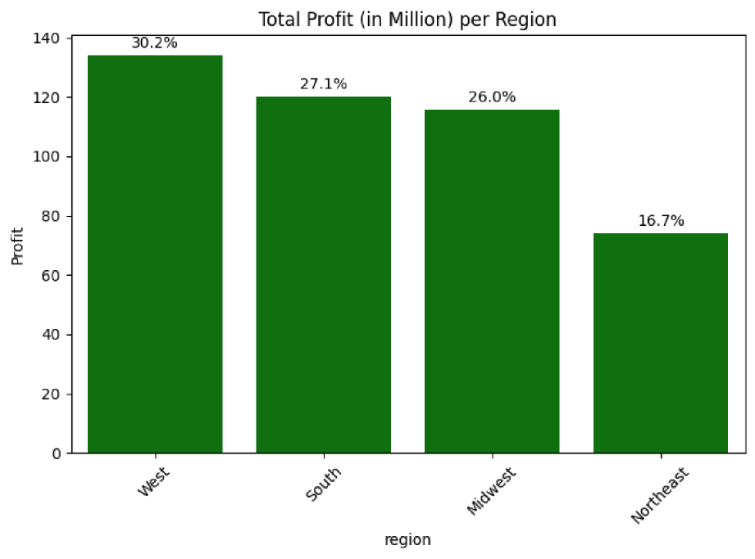
NORTHERN HAMMER | SALES ANALYSIS - MAKING THE FUTURE MORE PROFITABLE AGAIN
34
Profit per Region 2014-2017
$134M
MOST PROFIT IN THE WEST
$74M
LOWEST PROFIT IN THE NORTH EAST
~$117M
SOUTH AND MIDWEST

Slide 36
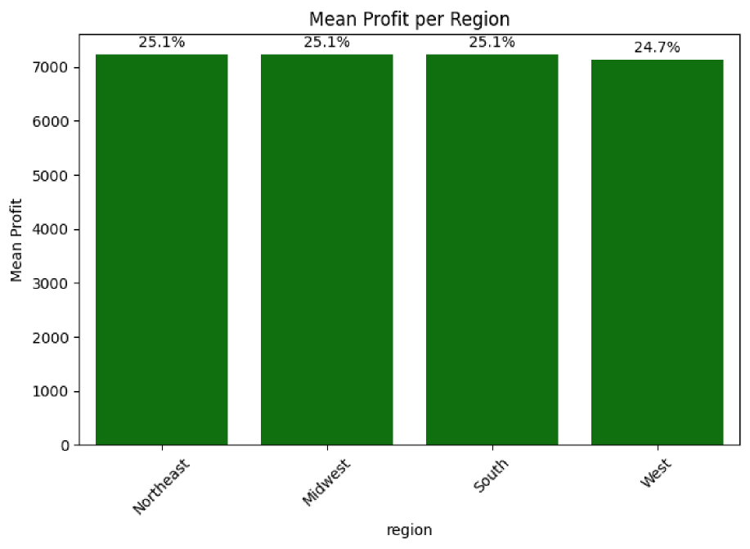
NORTHERN HAMMER | SALES ANALYSIS - MAKING THE FUTURE MORE PROFITABLE AGAIN
35
Orders per Region 2014-2017
$134M
MOST PROFIT IN THE WEST
$74M
LOWEST PROFIT IN THE NORTH EAST
~$117M
SOUTH AND MIDWEST

Slide 37
NORTHERN HAMMER | SALES ANALYSIS - MAKING THE FUTURE MORE PROFITABLE AGAIN
36
Key Insights
West → Strongest sales region
30.5% of Orders & 29.5% of Profit
North East → Weakest sales region
16.6% of Orders & 16.8% of Profit
Equal average profit per order
The average profit per region is equal for all channels

